Slide 1
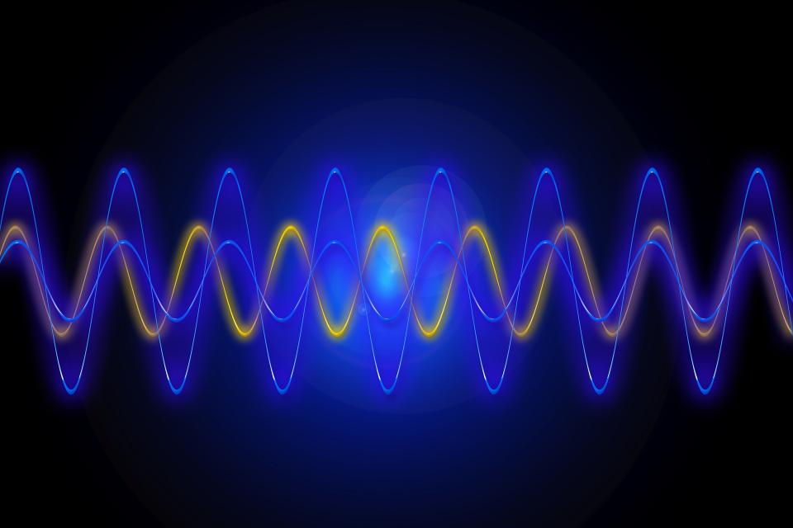
Book : Intelligent Fault Diagnosis and Remaining Useful Life Prediction of Rotating Machinery
Signal processing and feature extraction
Muhammad Umar
Graduate Research Assistant
Ulsan Industrial Artificial Intelligence Laboratory

Slide 2
Signal Categories
Signals
Stationary
Nonstationary
Random
Deterministic
Continuous
Transient
Periodic
Quasiperiodic
Cyclostationary
Continuously Varying

Slide 3
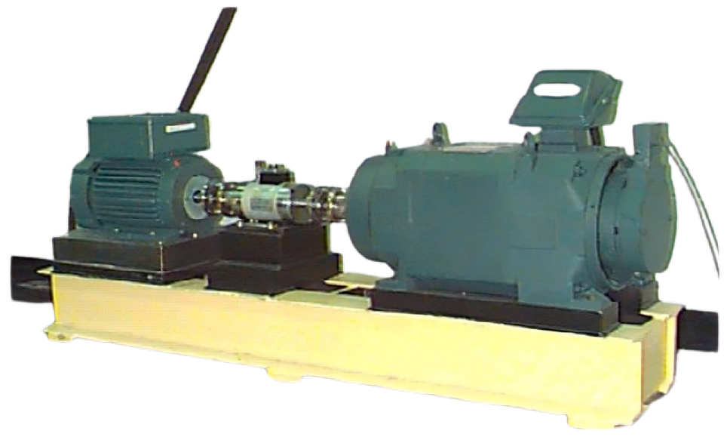
Signal Preprocessing
Signals
Mean Removal
Signal Preprocessing
Trend Removal
Signal Filtering
Signal Processing
Signal Processing in the Time Domain
Correlation Analysis
Time-Domain Feature Extraction

Slide 4
MEAN REMOVAL
Aim is to center signal around zero.
Mean Removal in Time Domain
Mean Removal in Frequency Domain
Amplitude (g)
2
Amplitude (g)
1.5
1
Mean = 1
1
0.5
Characteristic frequency
0
0
5
10
15
20
0
1
2
3
4
5
Time (s)
Frequency (Hz)
Amplitude (g)
1
Amplitude (g)
1
0.5
0.8
0
0.6
Mean = 0
0.4
Characteristic frequency
-0.5
0.2
-1
0
5
10
15
20
0
1
2
3
4
5
Time (s)
Frequency (Hz)
Figure: Mean Removal Illustrations

Slide 5
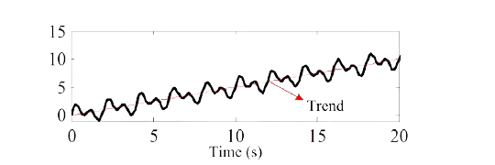
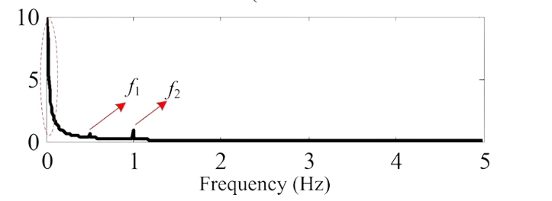
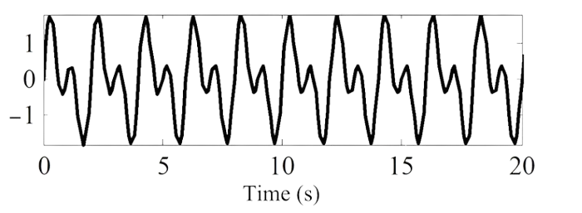
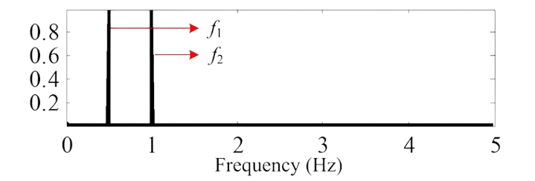
TREND REMOVAL
Aim is to remove seasonal variations or trends.
Trend Removal in Time Domain
Trend Removal in Frequency Domain
Figure: Trend Removal Illustrations

Slide 6

















Signal filtering
Ideal
Real
(A)
(B)
Filters remove unwanted components. (noise)
Filters are commonly divided into four categories:
Low-pass filters
High-pass filters
Bandpass filters
Band-stop filters
|H($jω$)|
|H($jω$)|
$$ω_{c}$$
$$ω$$
$$ω_{c}$$
$$ω$$
(C)
(D)
|H($jω$)|
|H($jω$)|
|H($jω$)|
$$ω_{c1}$$
$$ω_{c2}$$
$$ω$$
$$ω_{c1}$$
$$ω_{c1}$$
$$ω_{c2}$$
$$ω_{c2}$$
$$ω$$
Figure: Amplitude-frequency characteristics of filters

Slide 7
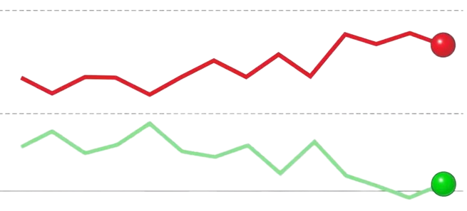
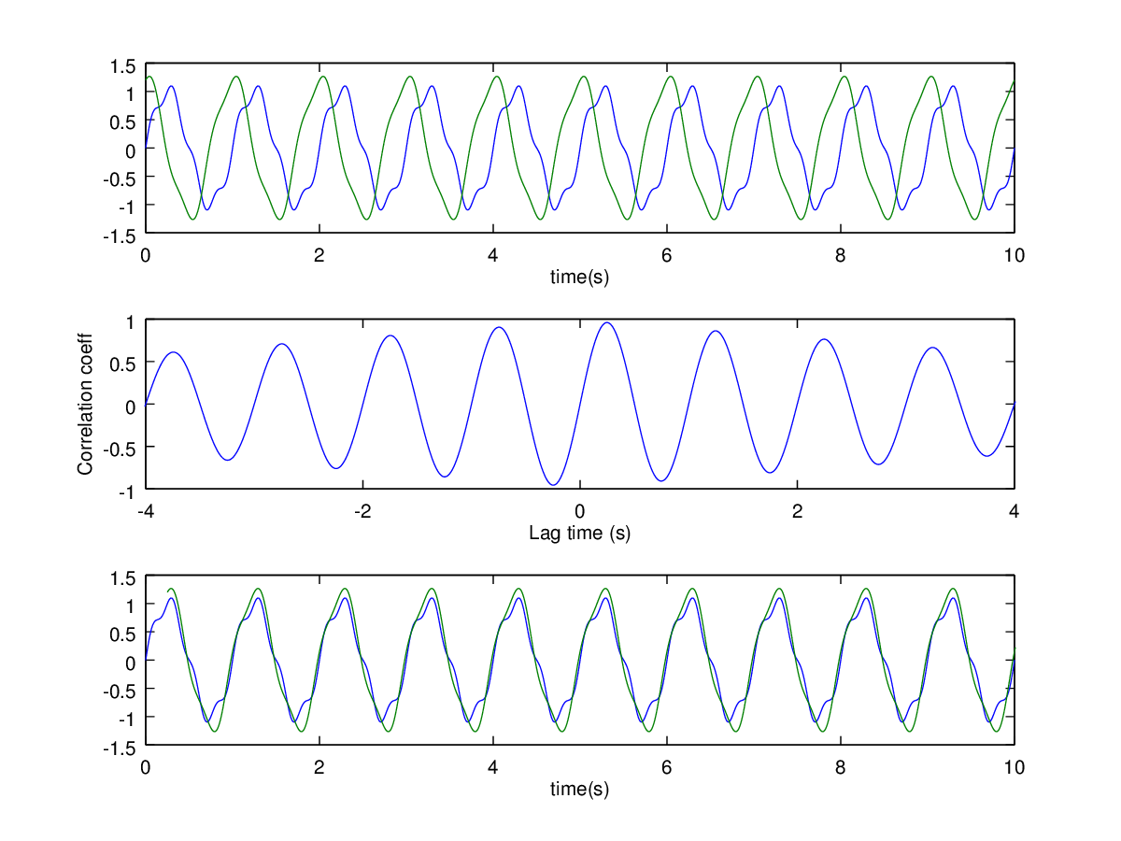
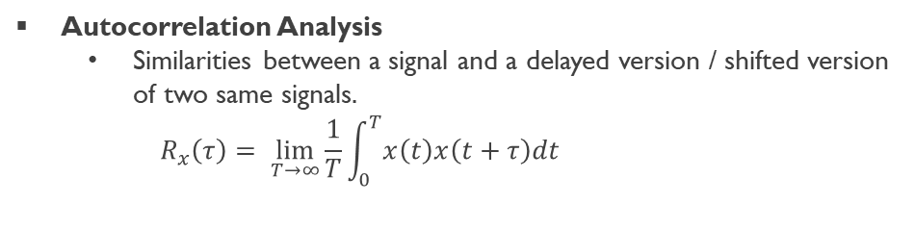

Correlation Analysis and types
Fundamental tool in signal processing
Helps how closely two signals are related
Autocorrelation Analysis
Similarities between a signal and a delayed version / shifted version of two same signals.
$$R_{x}\left(τ\right)= \lim_{T→∞}{\frac{1}{T}\int_{0}^{T}{x\left(t\right)x\left(t+τ\right)dt}}$$
Figure: Autocorrelation of two signals
Cross-Correlation Analysis
Similarities between two different signals.
$$R_{xy}\left(τ\right)= \lim_{T→∞}{\frac{1}{T}\int_{0}^{T}{x\left(t\right)y\left(t+τ\right)dt}}$$
Figure: Cross correlation of two signals

Slide 8




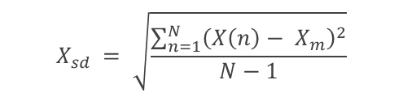







time domain Features in Statistical domain
Mean ($X_{m}$)
Average
$$X_{m}= \frac{\sum_{n=1}^{N}{X(n)}}{N}$$
$$X_{sd} = \sqrt{\frac{\sum_{n=1}^{N}{{\left(X\left(n\right)− X_{m}\right)}^{2}}}{N−1}}$$
Standard Deviation ($X_{sd}$)
Spread
Root ($X_{root}$)
Origin or base of signal
$X_{root}$ = $\left(\frac{\sum_{n=1}^{N}{\sqrt{|x\left(n\right)|}}}{N}\right)$
$$X_{rms} = \sqrt{\frac{\sum_{n=1}^{N}{{(x\left(n\right))}^{2}}}{N}}$$
Root Mean Square ($X_{rms}$)
Energy of the signal
Peak Value ($X_{peak}$)
Maximum value of signal
$X_{Peak}$ = max |x(n)|
Asymmetry of the signal
$$X_{skewness}= \frac{\sum_{n=1}^{N}{{\left(X\left(n\right)− X_{m}\right)}^{3}}}{\left(N−1\right)X_{sd}^{3}}$$
Skewness ($X_{skewness}$)
Kurtosis ($X_{kurtosis}$)
Impulsiveness
$$X_{kurtosis}= \frac{\sum_{n=1}^{N}{{\left(X\left(n\right)− X_{m}\right)}^{4}}}{\left(N−1\right)X_{sd}^{4}}$$
Table: Time–Domain Statistical Features

Slide 9








Cont.…
Crest Factor ($X_{crest}$)
Peak of the signal
$$X_{crest}= \frac{X_{peak}}{X_{rms}}$$
Clearance Factor ($X_{clearance}$)
$$X_{clearance}= \frac{X_{peak}}{X_{root}}$$
Peakness indicator
Shape Factor ($X_{shape}$)
Form of the signal
$$X_{shape}= \frac{X_{rms}}{\frac{1}{N}\sum_{n=1}^{N}{|X\left(n\right)|}}$$
Impulse Factor ($X_{impulse}$)
Spikes in signal
$$X_{impulse}= \frac{X_{peak}}{\frac{1}{N}\sum_{n=1}^{N}{|X\left(n\right)|}}$$
Table: Time–Domain Statistical Features

Slide 10
Thank you

